Slide 1

人工智能核心能力培养 — Lecture 03 The Kernel Ability For Artificial Intelligence
高民权

Slide 2
Review
What’s the optimization problem?
What’s the dynamic programming?
What’s the machine learning?
What’s the supervised learning and unsupervised learning?
What’s the most important for an algorithm engineer?
What’s the k-means and how to use it?

Slide 3
today
1. 线性回归 linear regression
2. 逻辑回归 logistic regression
3. softmax, cross-entropy
4. 正则化 regularization
5. 交叉验证 cross-validation

Slide 4
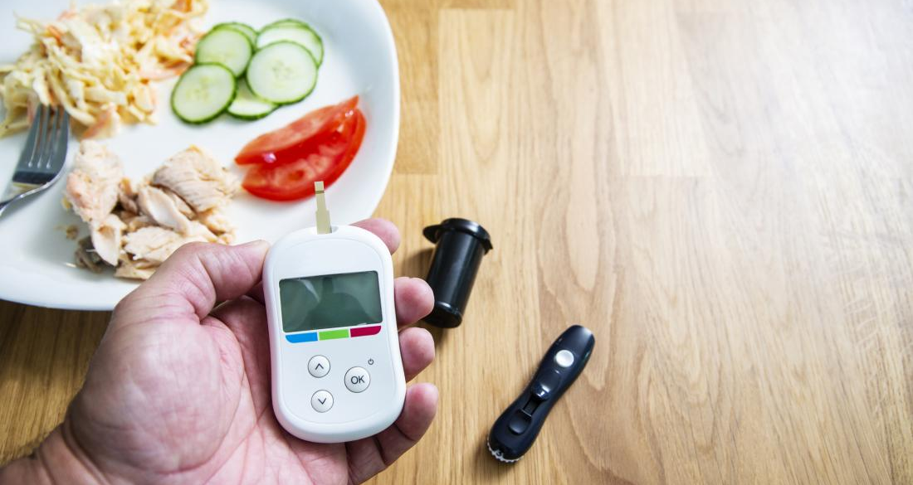
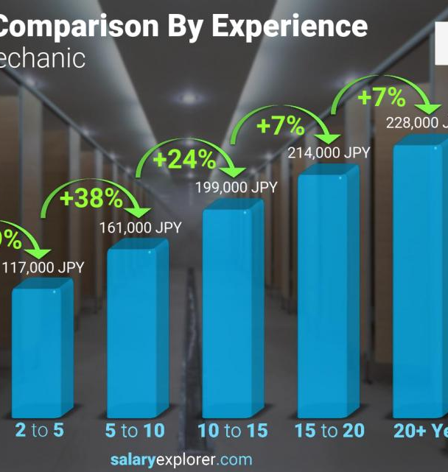
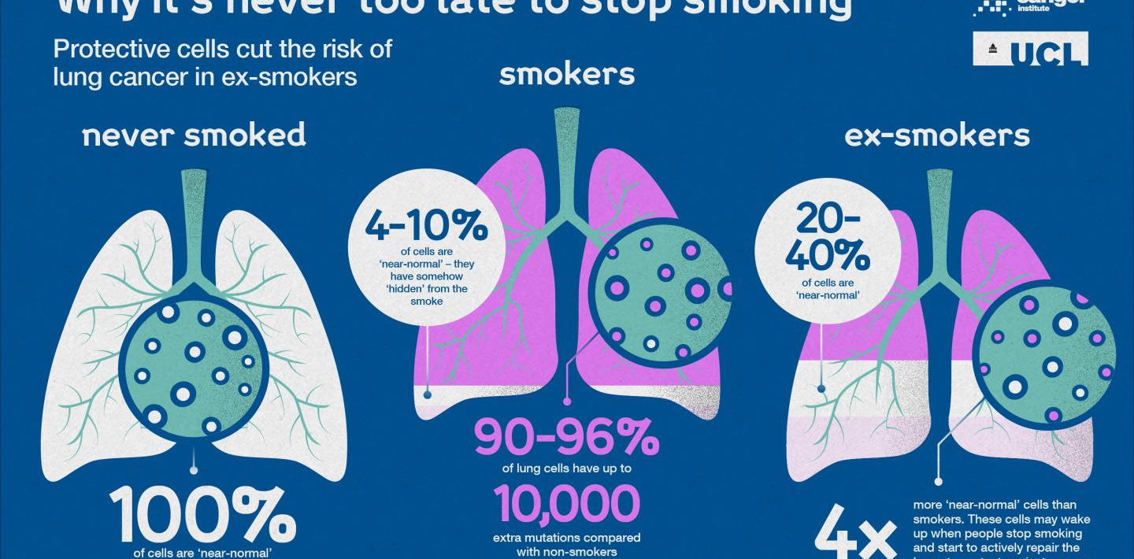

Slide 5
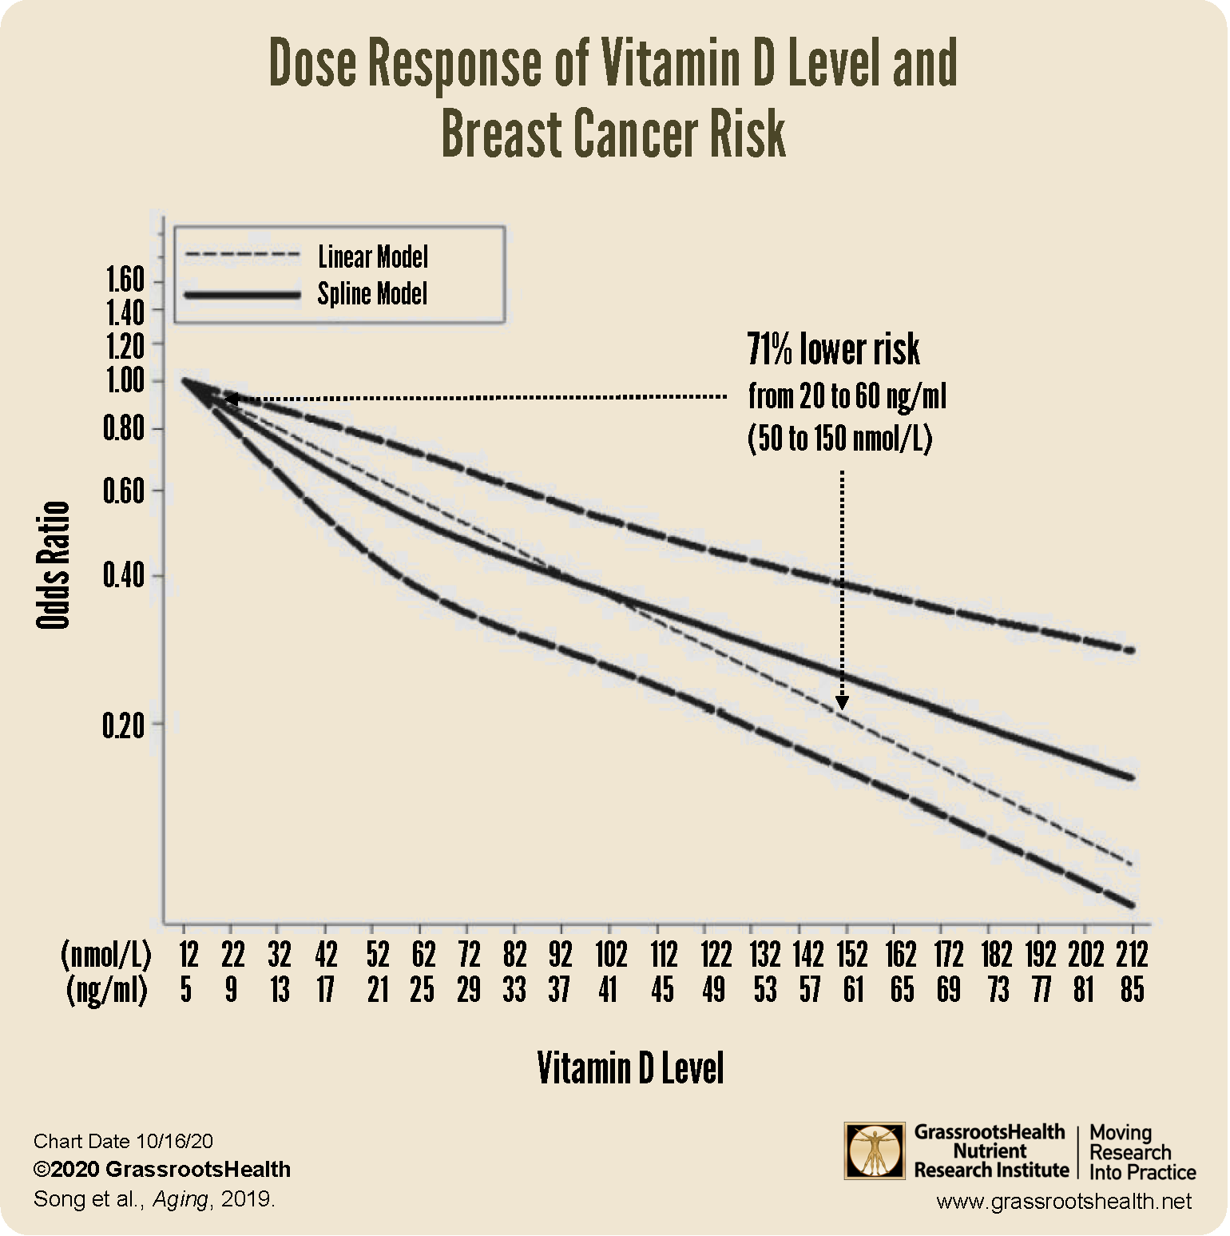
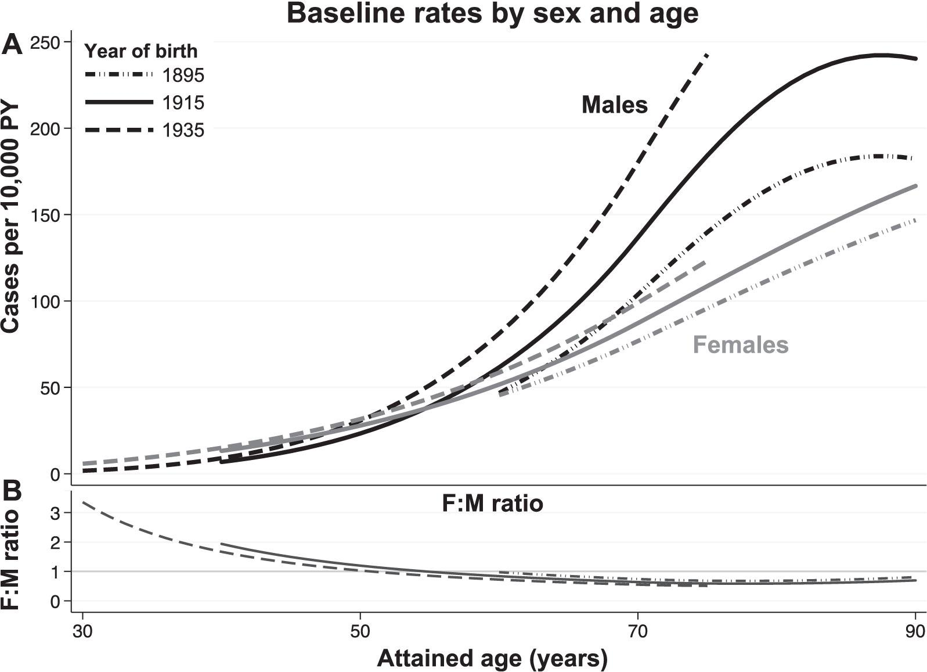
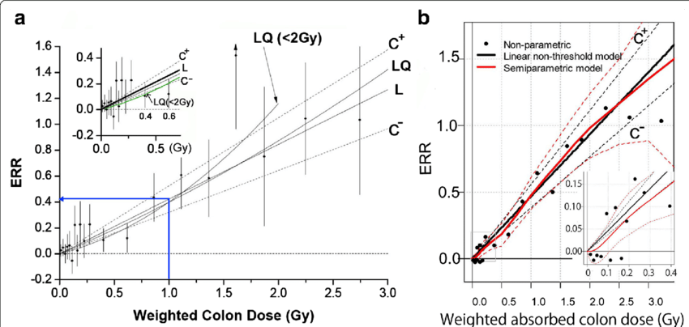

Slide 6

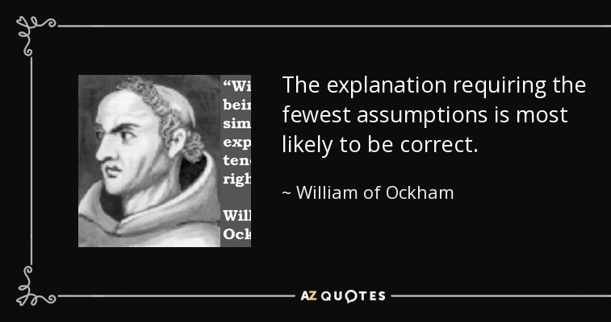
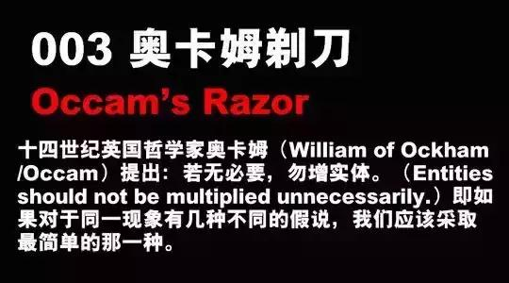

Slide 7
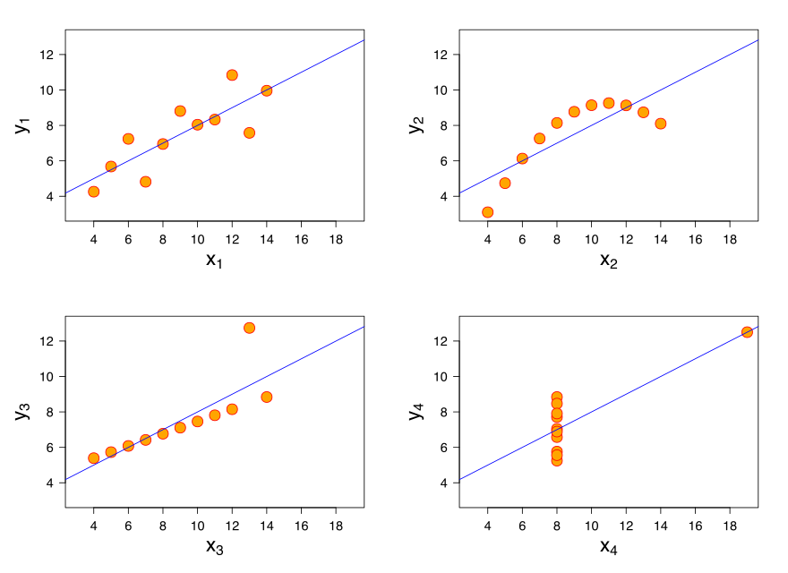
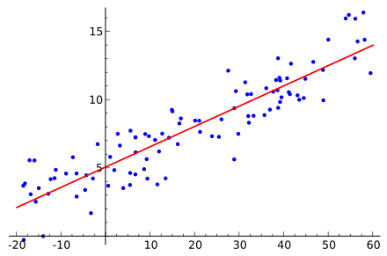

Slide 8



0.75
Regression
Supervised Learning
监督式学习
1 / -1
Binary Classification
$\vec{man}$= [
1.73
18000
1
00010
28
]
$\vec{email}$= [
213
1
27
0
]
(0.2, 0.7, 0.1)
Multiclass Classification
$$f_{1}$$
acttion1, action2,
…
actionN
Sequence Learning
1
2
3
4
Rank
3
2
4
1
Talk about the applications of different
machine learning types

Slide 9
we will search for a choice of θ that minimizes:
L2-distance
L1-distance

Slide 10
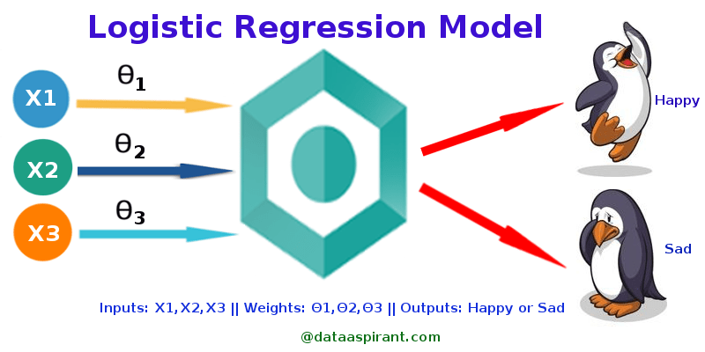
LogIstic regression

Slide 11
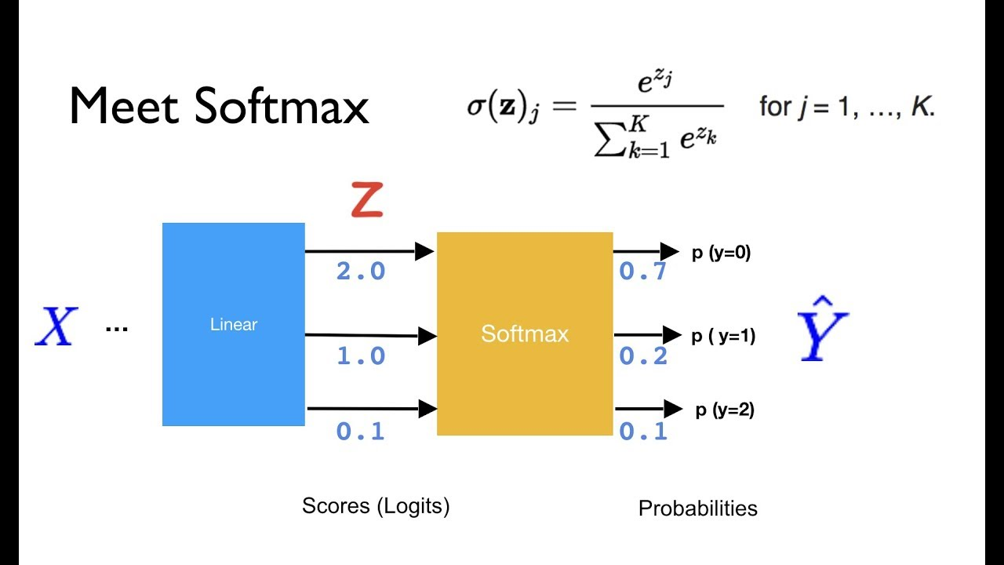
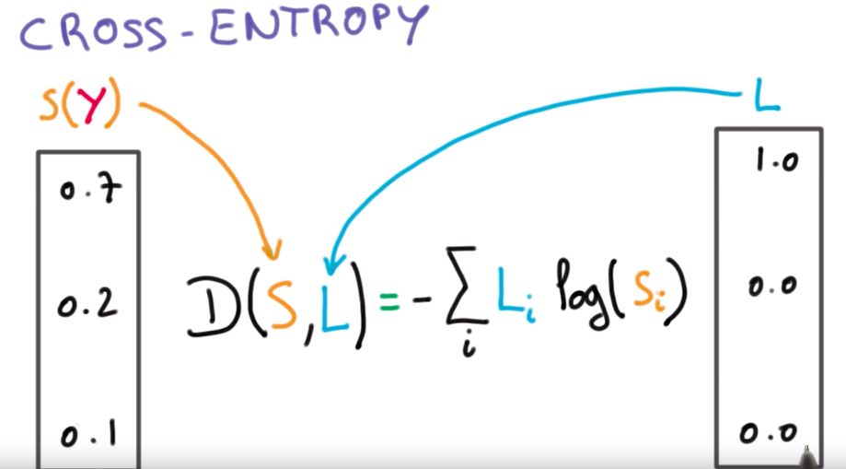
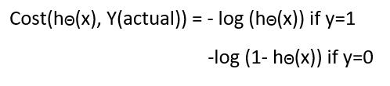
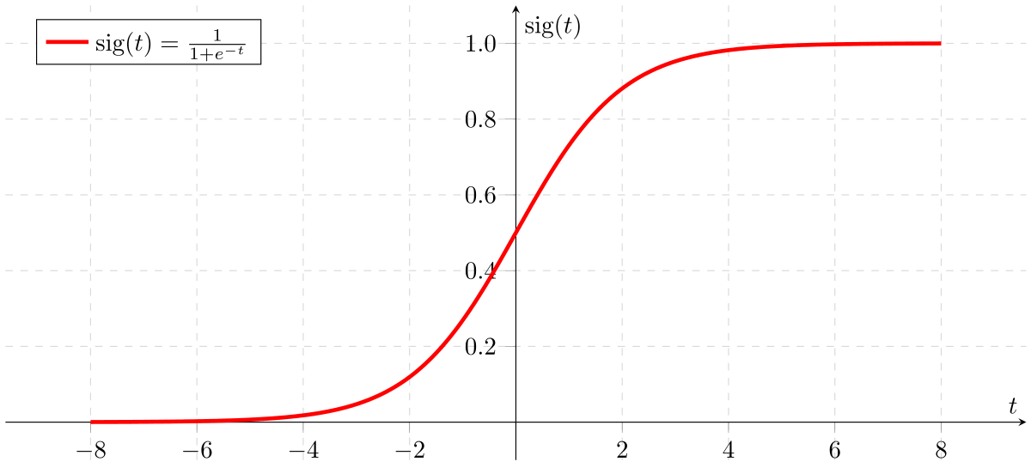
Logstic regression loss function
Cross-entropy loss for categorical classification

Slide 12

Programminig 03-01
>> softmax
>> cross-entropy
>> implementation of linear regression
>> implementation of logistic regression

Slide 13

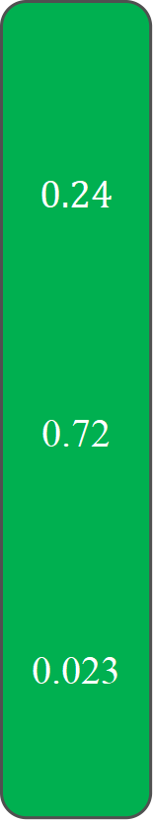
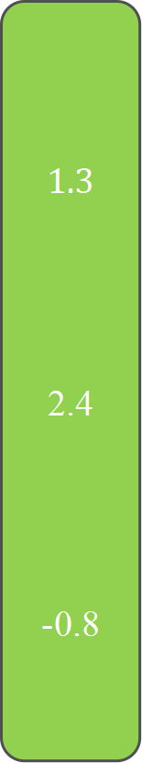

Pipie line of classification (deep learning classification)
$$\vec{x}$$
$$1.3$$
2.4
-0.8
$$0.24$$
0.72
0.023
$$0$$
1
0
cross-entropy
F(x)
softmax
wx + b
Y-true

Slide 14
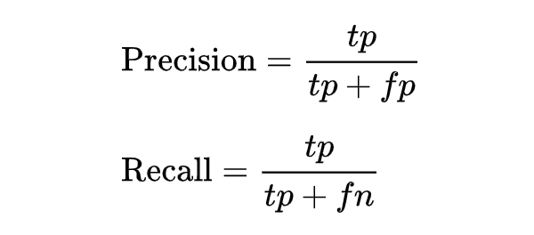
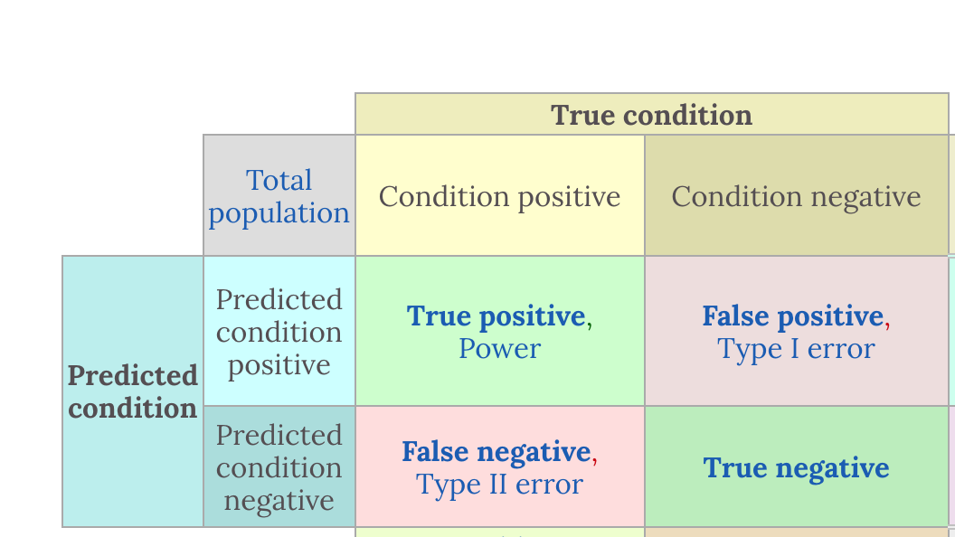
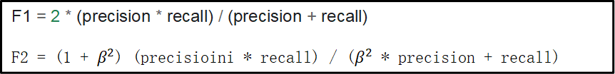
How to evaluate?
Baseline
Accuracy
Precision
Recall
ROC/AUC
F1_score, F2_score
F1 = 2 * (precision * recall) / (precision + recall)
F2 = (1 + $β^{2}$) (precisioini * recall) / ($β^{2}$ * precision + recall)

Slide 15
Observed Objects
P1
P2
G | B | G | G | G | B
G | G | G | G | G | G
G | G | B | B | G | G
G | G | G | G | G | B
G | G | B | G | G | G
G | G | G | G | G | G
G | G | G | G | G | G
G | G | G | G | G | G
G | G | G | G | G | G
G | G | G | G | G | G
G | G | G | G | G | G
G | G | G | G | G | G
B | B | B | B | B | B
B | B | B | B | B | B
B | B | B | B | B | B
B | B | B | B | B | B
B | B | B | B | B | B
B | B | B | B | B | B
P3
P4
P5
G | G | G | G | G | B
G | G | G | G | G | B
G | G | B | B | G | G
G | G | G | G | G | G
G | G | B | G | G | G
G | G | G | G | B | B
G | G | G | G | G | B
G | G | G | G | G | G
G | G | B | B | G | G
G | G | G | G | G | G
G | G | B | G | G | G
G | G | G | G | G | B
G | G | G | G | G | G
G | G | G | G | G | G
G | G | G | G | G | G
G | G | G | G | G | G
B | B | B | B | B | B
B | B | B | B | B | B

Slide 16
Question
A | B | A | B
A | A | B | A
B | B | B | B
A | A | B | A
A | B | A | A
A | B | A | B
B | A | B | B
B | B | A | B
A | A | A | B
A | A | B | A

Slide 17
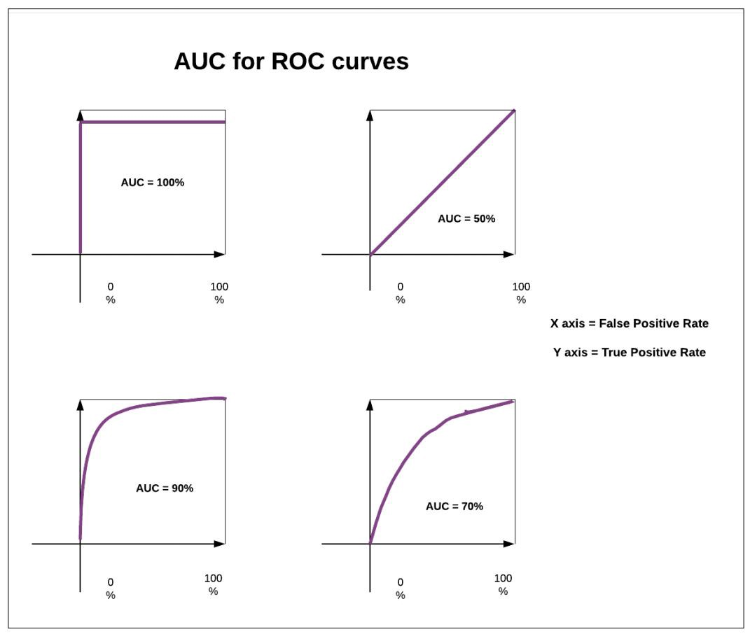
Auc for very unbalanced data

Slide 18
Question
A | B | A | B
A | A | B | A
B | B | B | B
A | A | B | A
A | B | A | A
A | B | A | B
B | A | B | B
B | B | A | B
A | A | A | B
A | A | B | A
A | B | A | B
A | A | B | A
B | A | A | A
B | B | A | A

Slide 19
A | B | A | B
A | A | B | A
B | B | B | B
A | A | B | A
A | B | A | A
B | B | B | A
B | B | A | A
B | B | A | A
B | A | A | A
A | B | B | B

Slide 20
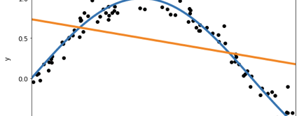
Overfitting & Underfitting
Why?

Slide 21
Outliner
What’s outliner and how to detect?
Percentile（25 percentile, 75percile）

Slide 22
Bias and Variance
dilemma
The bias is an error from erroneous assumptions in the learning algorithm. High bias can cause an algorithm to miss the relevant relations between feature and target outputs. (underfitting);
The variance is an error from sensitivity to small fluctuations in the training set. High variance can cause an algorithm to model the random noise in the training data, rather than the intended outputs (overfitting).

Slide 23
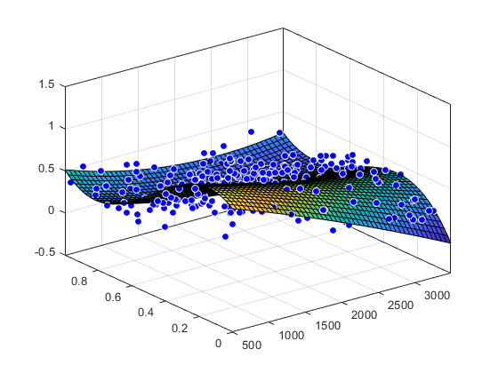
Dimension curse 维度灾难
The more dimension
The more and more … data need
过拟合 Overfitting | 欠拟合 Underfitting
训练数据占总体数据过少 | 训练数据占总体数据过多
模型过于复杂 | 模型过于简单
采样过于不均衡 | 采样过去全部
没有正则化 …

Slide 24
Train, validation, test
Good Memory V.S Good Learning

Slide 25
Train, validation, test
Good Memory V.S Good Learning

Slide 26

New
Data
特征提取
Feature extractor
Framework 机器学习的通用框架
x
1
3
2
Observed
Data
$$θ$$
Loss function
特征提取
Feature extractor
向量
vector
学习
Learning
f
Acc / precision
X1 = [0.1, 0.21,
0.33, 0.98]
Y1 = [0, 0, 1]
4
y
X2 = [0.23, 0.98,
0.33, 0.98]
Y2 =[ 0, 1, 0]
Gradient Descent
X3 = [0.143, 0.87,
0.1 0.98]
Y3 = [1, 0, 0]
What’s the difference of Supervised Learning and Unsupervised Learning?

Slide 27

Feature scaling
Training data split
Normalization
standardized
One-hot

Slide 28
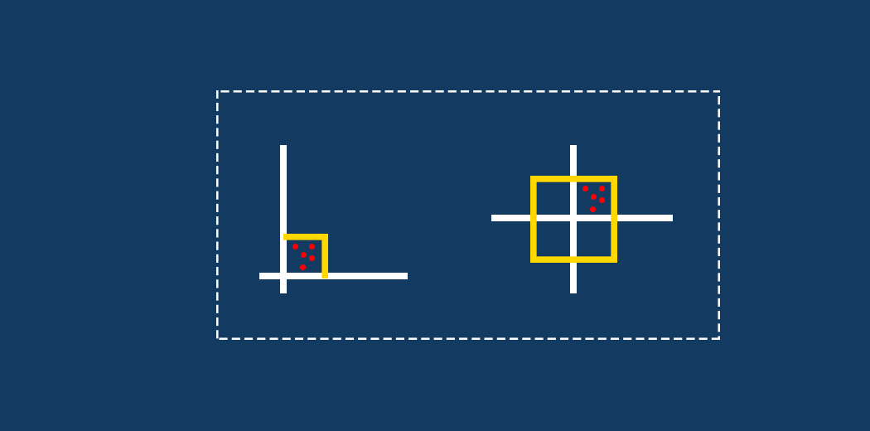
数值归一化和标准化 Normalization and standardized

Slide 29
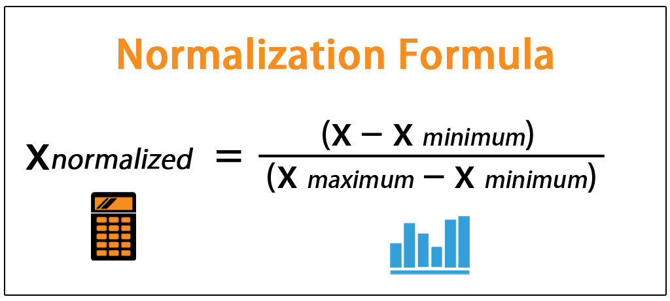
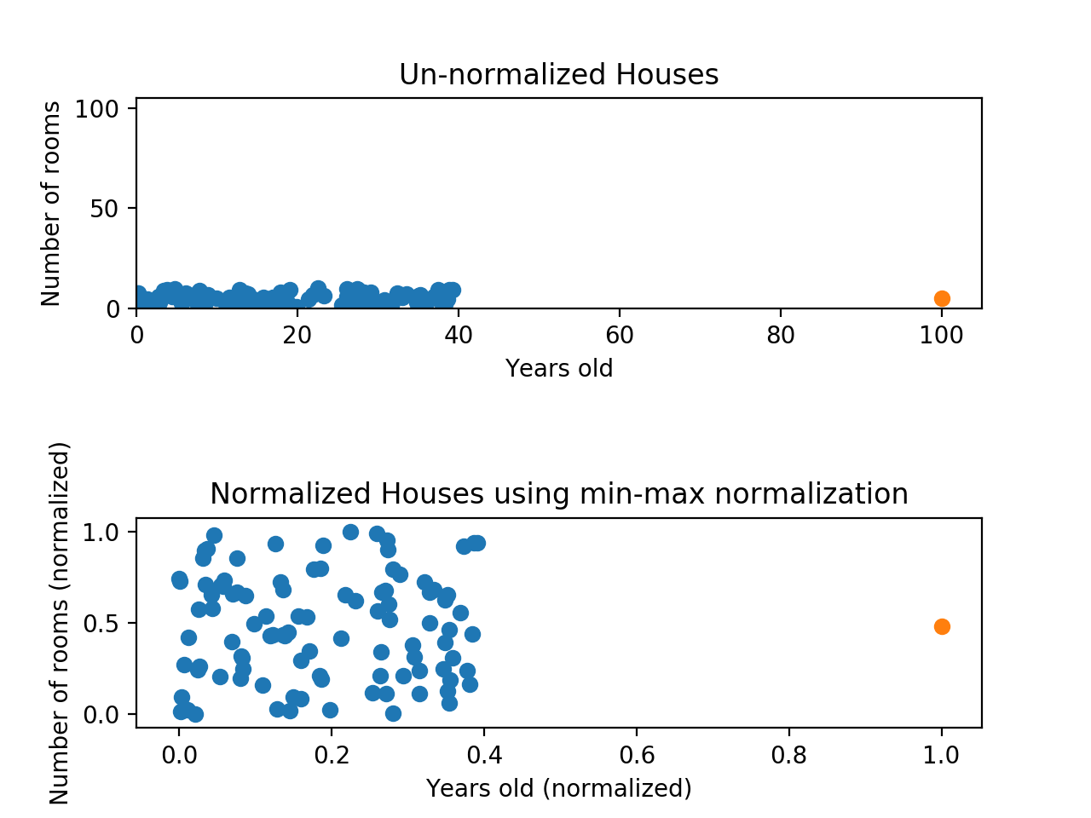
Max-min scalar (normalize)

Slide 30
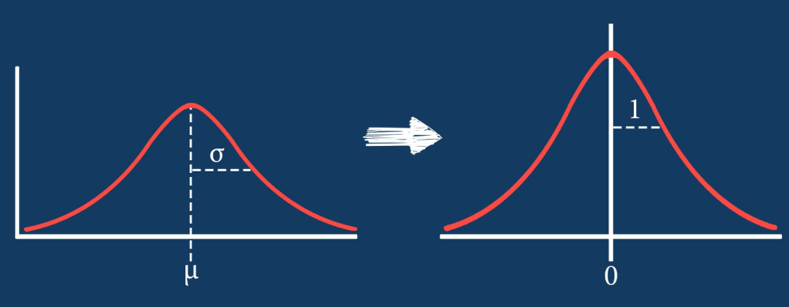
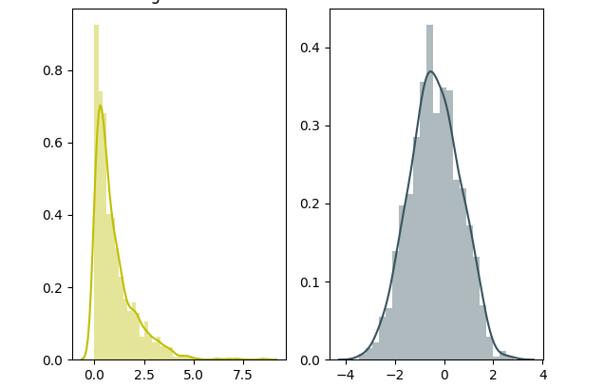
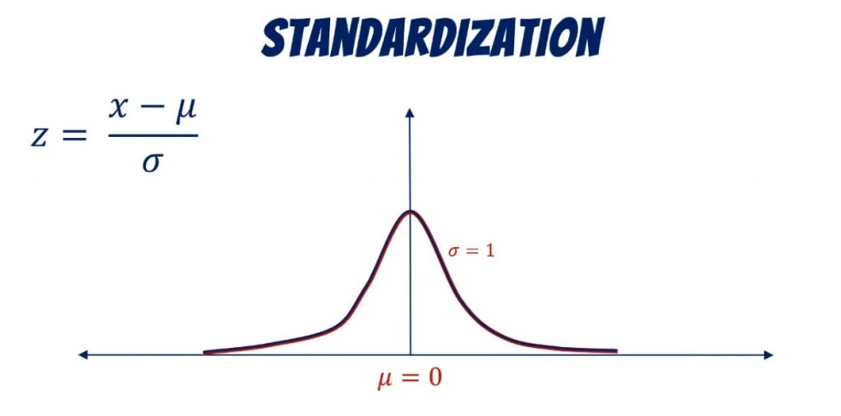
Data standardized

Slide 31
The problem from homwwork: One-hot coding
All are numbers

Slide 32
Categorical & Numerical
What’s the different?

Slide 33
Categorical
Could not be compared
Could not be sorted
The Number just is a
representation
Numerical
Could be compared
Could be sorted
The number with attribute

Slide 34
Why it counts?

Slide 35
One-Hot and Embedding

Slide 36
Programminig 03-02
>>> one-hot
>>> normalization and standardized

Slide 37

NOW are are read for a whole classification task
现在我们已经做好准备解决完整的分类问题了

Slide 38
Programming-04-01 Linear regression principle and method
>>> implement linear regression solve house price problem
>>> the scikit learning for linear regression

Slide 39
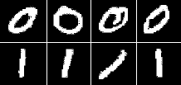
Programming – 04- 02 Binary classification problem
Biniary digital classification

Slide 40
Homework
1. 实现softmax，cross-entropy，并且说明他们的使用场景和作用意义； 2. 总结过拟合、欠拟合的作用和意义 3. 总结AUC的作用和意义 4. 城市里边有一共200万个居民，其中有100人是犯罪分子，然后警察随机找了一批人，这批人一共200人： 现在定义犯罪分析为positive samples, 那么 case1: 警察定义的这200人中，一共有犯罪分子实际有89人，警察判定是犯罪分子的人一共有80人，这80人中，真正是犯罪分子的有79名；请问，警察判断的accuracy是多少，recall是多少，precision是多少？ case2: 警察定义的这200人中，一共有犯罪分子实际有100人，警察判定是犯罪分子的人一共有200人，这200人中，真正是犯罪分子的有100名；请问，警察判断的accuracy是多少，recall是多少，precision是多少？

